Slide 1
Monthly Update on 2018-2019 WRAP Workplan May 27th, 2020 TSC and Work Group Co-Chairs Call
Tribal Data WG
Fire and Smoke WG
Oil and Gas WG
Regional Technical Operations WG
Regional Haze Planning WG

Slide 2
Tribal Data Work Group
No Updates

Slide 3
Fire and Smoke Work Group

Slide 4
Workplan Progress by Fire and Smoke Work Group
Workplan Progress over the Last Month
Held final workgroup call on April 6.
All deliverables submitted.
Website being finalized.
Activities for the Next Two Months / Future
Proposed specifications for fire activity data/emissions tracking system to follow from Tom and Matt Mavko.
Hold Fire and Smoke discussion call on July 20.

Slide 5
Oil and Gas Work Group

Slide 6
Progress by Oil and Gas Work Group
Workplan Progress and Coordination
OGWG Workplan Tasks Complete
Tasks over the Last Month
OGWG Self-Assessment
April 14, 2020 OGWG Bi-Monthly Call
Coordination - Integration for WRAP OGWG Base and Future Year Emissions Inventories in National Collaborative Platform
Tasks for the Next Several Months
OGWG transition communication and to potential additional future project(s)

Slide 7
Proposed Future Oil and Gas Projects
Potential Additional Future Project/s
OGWG input from members/advisors
Extend period of performance Ramboll contract (e.g., state specific assistance)
Annual compilation of agency program review (i.e., capture regulatory changes)
Potential for contractor specific support needs as identified and funded
Future OGWG Communication Calls (every 4 months)
Track oil & gas sector and keep up to date via roundtable
Topic specific updates (e.g., BLM analyses using WRAP/OGWG work products)
Identify additional WRAP assistance
Next Call August 11, 2020

Slide 8
Regional Technical Operations Work Group

Slide 9
Workplan Progress by RTOWG
Workplan Progress over the Last Month
Weekly co-chair coordination calls
Weekly calls with Ramboll to keep track of modeling progress
RTOWG call on 4/29
Ramboll modeling progress report
Summary comparing 2028 Regional Haze projections using WRAP modeling results to date to EPA 2016-based results
Overview of projections methods
Review draft of May 19-20 WebEx/call agenda on TSS-delivered Regional Haze monitoring/emissions/PAC1 vs. OTB projections results

Slide 10
Workplan Progress by RTOWG
Workplan Progress over the Last Month (cont’d)
Updates to CA emission inventory
2028 source apportionment spec sheet posted for comment
Weighted emission potential (WEP) spec sheet updated

Slide 11
Workplan Progress by RTOWG
Workplan Tasks for the Next Two Months
Future year (2028) CAMx source apportionment simulation
Continue development of evaluation tools for emissions and model results
Calculate and display 2028 Reasonable Progress Goals (RPG)
WRAP modeling meeting (online): June 23 & 25
Use the TSS2 to review interpretation methods for haze modeling results
Day 1: projections to 2028
Day 2: evaluation of source apportionment, emission sensitivity, and WEP/AOI results
Dynamic Model Evaluation

Slide 12
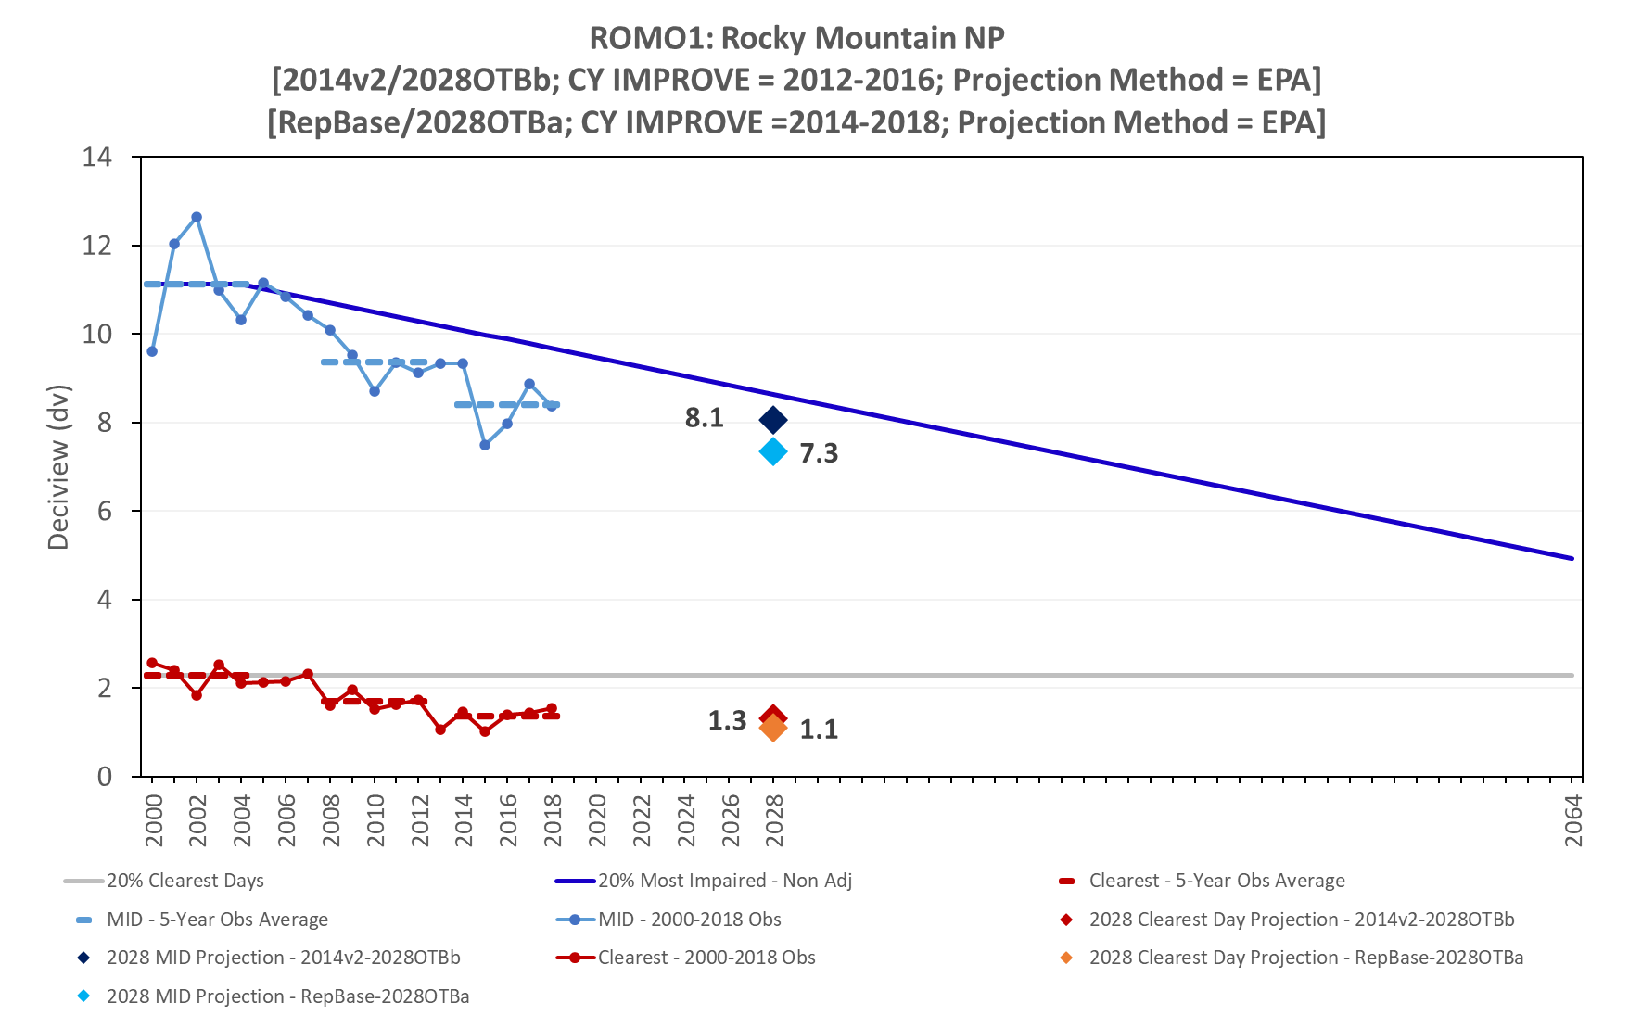
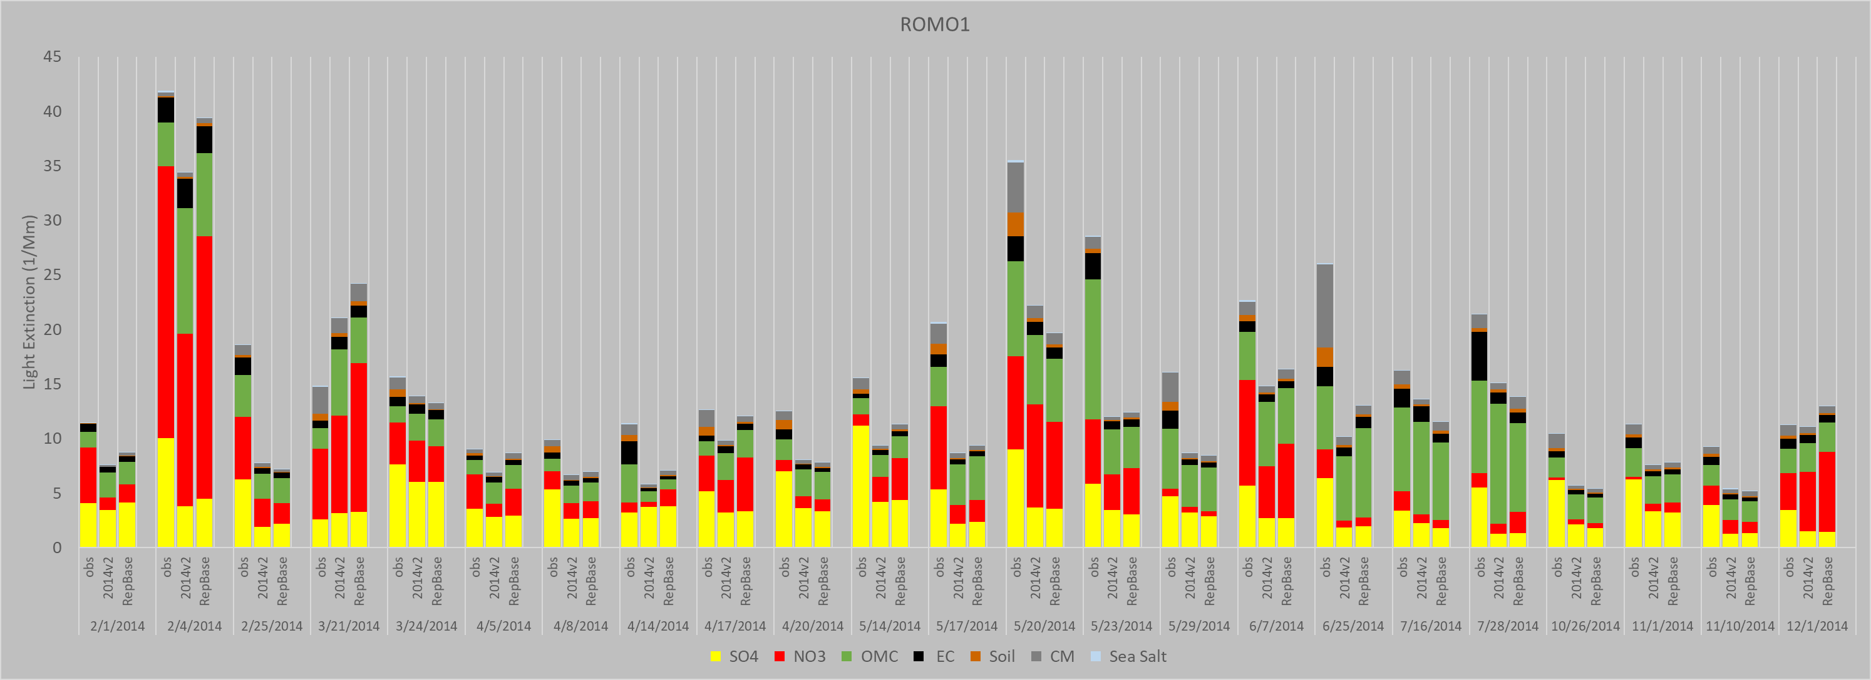
Workplan Progress by RTOWG
Workplan Tasks for the Next Two Months (cont’d)
Evaluation of future visibility projection methods
EPA – default
EPA – corrected for fire and dust impacts
Modeled Most Impaired day (ModMID) – Use MID from modeled SO2 and Nox
Greatest IMPROVE Sample Day Population (GISDP) – Choose days that 1) minimize fire & dust impacts and 2) have best model performance

Slide 13
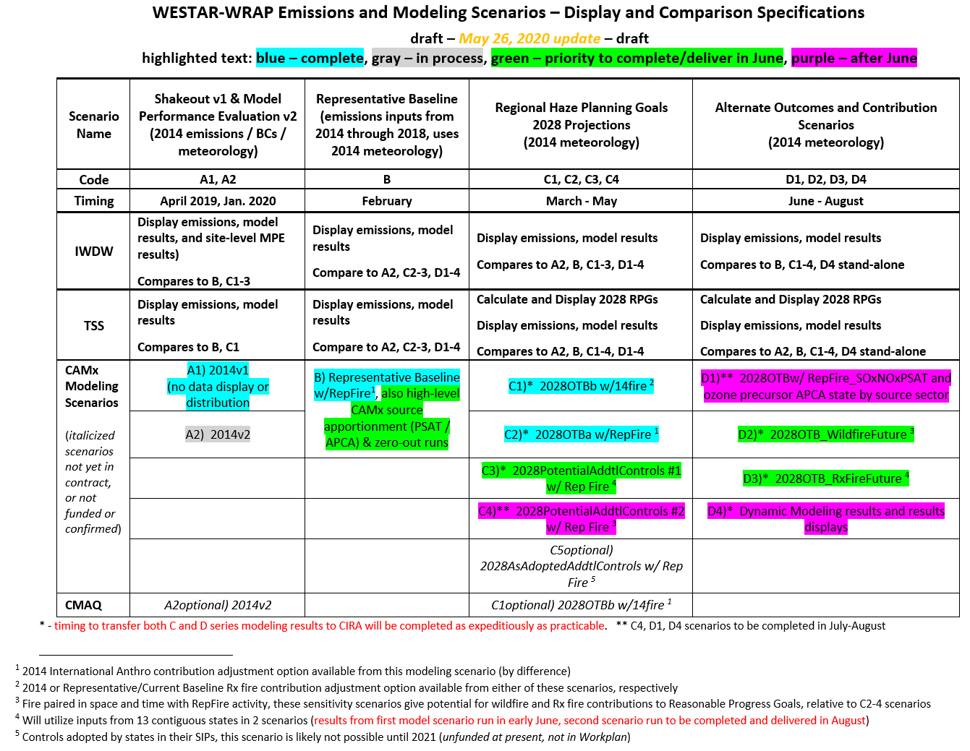
RTOWG modeling priorities

Slide 14
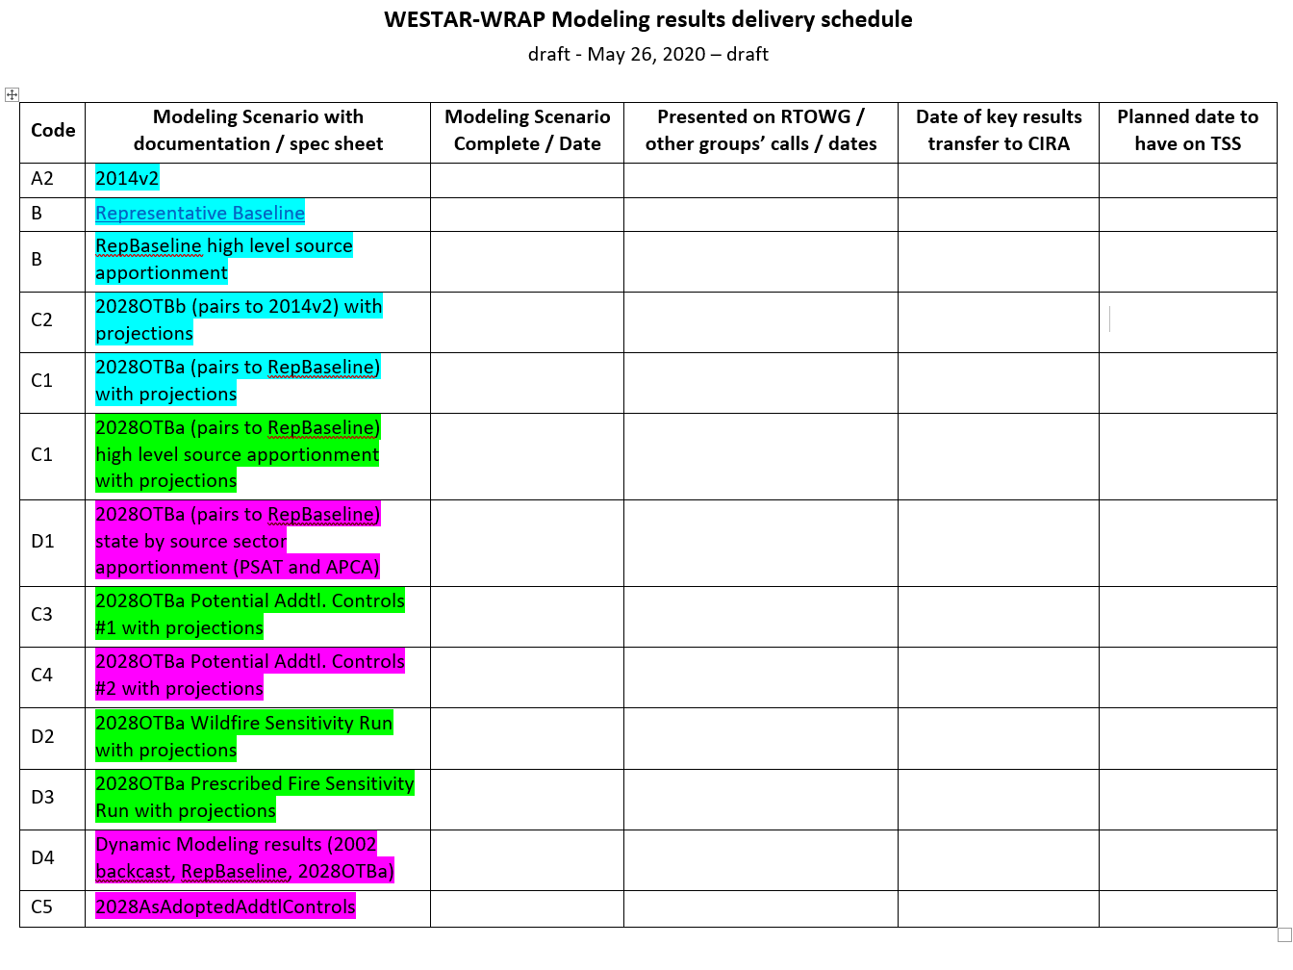
RTOWG modeling priorities

Slide 15
Workplan Coordination Activities by RTOWG
Workplan Coordination Occurring over the Last Month
Ramboll
Workplan Coordination Needed over the Next Two Months
Ramboll
Other workgroups as needed for investigating/discussing model results

Slide 16
Proposed Future Projects
Potential Additional Future Project/s
In addition to the particulate source apportionment results for haze, we will also have ozone source apportionment using CAMx’s APCA (“Anthropogenic Precursor Culpability Assessment”) diagnostic tool. This should be of interest to air quality planners for helping to understand regional ozone behavior and potential for future mitigation.

Slide 17
Regional Haze Planning Work Group

Slide 18
Workplan Progress by Regional Haze Planning Work Group
Workplan Progress over the Last Month
April 7 call
Round 1 2028 Potential Additional Controls summary of responses and next steps. States to submit by July 1, potential control inventory for an additional model run
Mobile Source Emissions Inventory Projections final memo and deliverables
WRAP State Regional Haze Progress Website
May 19-20 Virtual Workplan Completion meeting
Focused on Monitoring and Inventory Data accessibility on the TSSv2
Workplan Tasks for the Next Two Months
July 2020
July 2020
Notes:
1) RTOWG modeling - Ralph Morris (Slides to be posted to the RHPWG website after call) Update/progress presentation
Round 1 2028 Potential Additional Controls summary and next steps - David and Tom (Slides to be posted after call) Responses received from states and state summary of data/changes.
July 1, 2020 deadline for states to submit “refined” (or initial if not done 3/16) for additional modeling sensitivity run
4) Mobile Source Emissions Inventory Projections project. (David/Jay/Tom) Final memo and deliverables available on project wiki page: Mobile Source Emissions Inventory Projections Project
5) WRAP State Regional Haze Progress Website (Amber)

Slide 19
Workplan Coordination Activities by Regional Haze Planning Work Group
Workplan Coordination Occurring over the Last Month
Group meeting scheduled for April 7th
RTOWG modeling update
Emissions Inventory Subcommittee
Control Measures Subcommittee
May 19th-20th Workplan Completion Webinar
RTOWG
TDWG
FSWG
RHPWG Subcommittees
Workplan Coordination Needed over the Next Two Months

Slide 20
Workplan Progress by RH Planning Work Group – Control Measures Subcommittee
Workplan Progress over the Last Month
April call – states provided updates on 4-factor review work
Most states have received the requested source information and are reviewing source control options, feasibility and costs
Many states are starting internal discussions on emission control costs and the appropriate cost effectiveness threshold
Workplan Tasks for the Next Two Months
Next call on May 26th
States to continue 4-factor review work
States to review AOI and WEP analysis when it becomes available

Slide 21
Workplan Coordination Activities by RH Planning Work Group – Control Measures Subcommittee
Workplan Coordination Occurring over the Last Month
Participation on OGWG call
Workplan Coordination Needed over the Next Two Months
OGWG call participation

Slide 22
Proposed Future Projects by RH Planning Work Group – Control Measures Subcommittee
Potential Additional Future Project/s
Depending on progress of emission control decisions, States considering whether an extra modeling analysis could be done over the summer or early fall
Coordination with the Emissions Inventory and Modeling Protocol Subcommittee is necessary to estimate potential emission reductions and timing of modeling

Slide 23
Workplan Progress by Coordination and Glide Path Subcommittee
Workplan Progress for April-May
Group did not meet for May
TSSv2 Delivery Update, Emission Tools, and WEP Presentation
Storyboard status update
ARS Data Substitution and EPA Patched Data Memo review
Discussion on disseminating four factors to public.
Workplan Tasks for the Next Two Month
Continue oversight of TSSv2 development
Support creation of RH Storyboard
Testing of TSS tools

Slide 24
Workplan Coordination Activities by Coordination and Glide Path Subcommittee
Workplan Coordination Occurring over the Last Month
Coordination with CIRA (TSS)
Coordination with ARS (Data Substitution)
Coordination with Ramboll (WEP)
Workplan Coordination Needed over the Next Two Months
Continued engagement with CIRA, ARS, Ramboll

Slide 25
Workplan Progress by RHPWG EI&MP SC
Workplan Progress over the Last Month
Emissions loaded on TSS Express Tool
Preparation for NEI tables to be added to TSS Express Tool
Workplan Tasks for the Next Two Months
RTOWG contractor-supported reports and analyses
Work with states to get PAC v2 submitted

Slide 26
Workplan Coordination by RHPWG EI&MP SC
Workplan Coordination Occurring over the Last Month
Coordinated with other states/agencies as needed to analyze emissions on TSS.
Workplan Coordination Needed over the Next Two Months
Coordinate with contractor to get TSS emissions further updated.
Coordinate with contractor to transfer potential additional controls v2 emissions files from states.

Slide 27
End of Workplan Progress Update

